Slide 1
PSC Interns 2018 Final Report Presentation: Building a Data Pipeline for Calima Dashboard
Date: 2018/08/04
Intern: Alice (Chia-Hua Lee)

Slide 2
Agenda
Motivation
Data Pipeline
Data Source
Data Preprocessing
Dashboard Demo
Project Benefit for the Center

Slide 3

1. Motivation
Deliver
the right data
to the
right person
System Administrator
Consultants
…
Director
End Users
Notes:
These people are actually all seeking the same information but from different perspective. We are building a solution to deliver the data to their hand so that they can do their job more easily.

Slide 4

2. Data Pipeline

Slide 5
Calima Dashboard Data Pipeline
CSV files
Raw data
preprocess.py
Processed data
rubber.bridges.psc.edu
automate.sh
Execute command to extract data
Invoke python script to clean data
Copy the processed data to docker (inotifywait package)
Notes:
Elasticsearch is used in combination with Logstash & Kibana (known as an ELK stack) to quickly query data and visually represent it for analytics

Slide 6
Logstash
Notes:
Logstash is a fantastic tool for managing logs and shoving them into Elasticsearch
Logstash is an open source data collection engine with real-time pipelining capabilities. Logstash can dynamically unify data from different sources and we can writer script to clean the data before moving the data into destination which is elasticsearch

Slide 7
Elasticsearch under the hood - Lucene
Notes:
Elasticsearch is lucene based distributed text search engine capable of handling large document-oreiented data sets. Although it has certain features like Document-oriented Store, Schema free, Distributed Data Storage, Sharding, Replication etc However, people usually do not use it as the primary store. Elasticsearch, is typically used to store, index, search and analyze data in real-time which lets you extract value from the data.
Lucene indexes documents in a way that it creates inverted index for specified fields of the document. When you use ElasticSearch, you provide a query which undergoes tokenization, stemming etc. The tokenized keywords in your query are matched with the inverted index to retrieve documents where those keywords occur most frequently

Slide 8
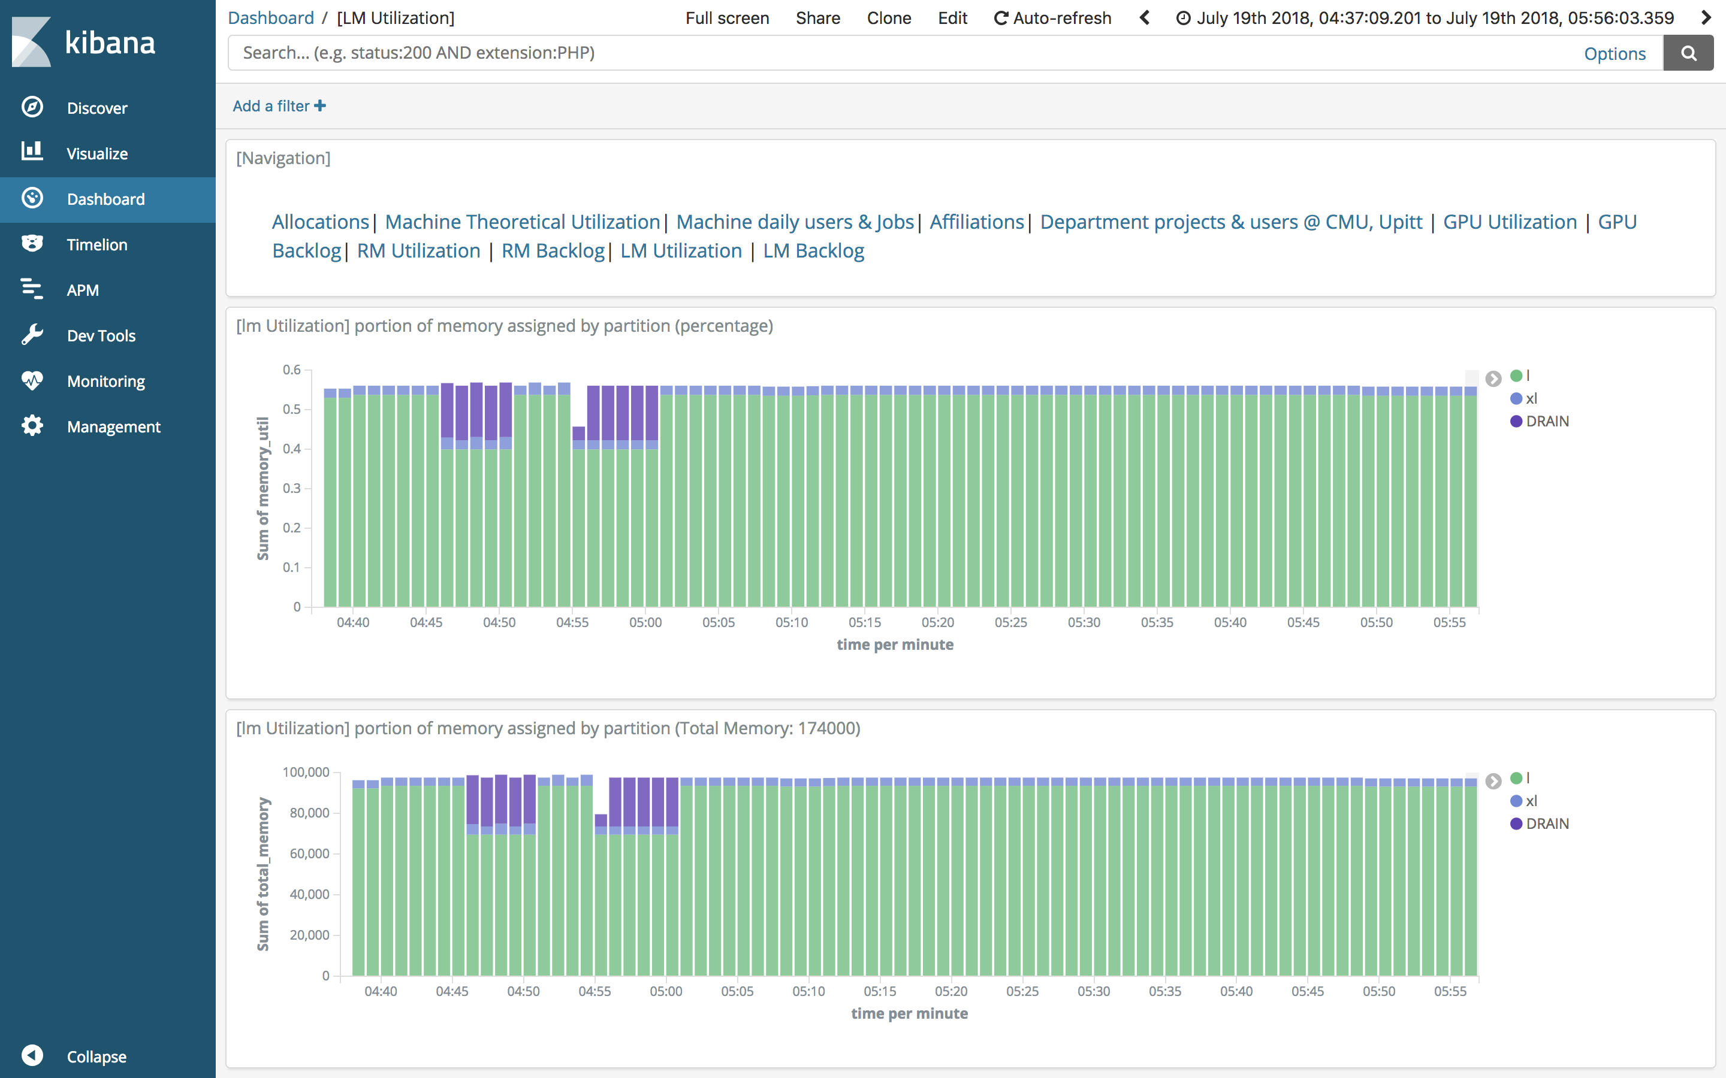
Kibana

Slide 9
3. Data Source

Slide 10
Data Source: Allocations
About Allocations Database
Development Environment: bell
Production Environment: noll
Data History: 2016/03/07 ~ now
Size of View on noll Databse: 8,883,000+ rows
# | Table Name | Brief Description
1 | public.subgrant | grant info
2 | Public. subgrantplatinfo | platform info: Reg, GPU, Large,SU allocations
3 | public.subgrantmach | machine Reg, GPU, Large
4 | platmachuser | grant/platform/machine/username
5 | users | grant/platform/machine/username
6 | nsfaffiliations | affiliations table (eg. CMU, Pitt, USC, etc..)
7 | public.jobs | subset of slurmdb focusing on jobs for accounting purposes
8 | public.prorated_jobs | Truncate jobs into daily basis
9 | Public.actions | new grant, renewal, supplement, time extension, SU amount

Slide 11

What is Allocations Database All About?
PI
Affiliation: PSC
pipscid: nystrom
Email: nick@psc.edu
Telephone: 412567983
Consultant
Subgrant Number
CDA090001P
MCB170031P
DMR160034P
RM 20000
Allocation
GPU 30000
RM 10000
RM 20000
LM 40000
Start - End
2017/07/08 -2019/04/04
Charge ID
pscstaff
mr5612p
ca8r6hp
Title
PSC Staff
Bridges Workshop
AI & BD Intern
UserID
User Name
JobID/SU charged/Machine

Slide 12

Allocations Relevant Dashboard Covers the following topics :
Allocations
Machine Theoretical Utilization
Number of Machine daily users & Jobs
Historical Resource Utilization on Different Machines by Affiliations
Resources Utilization by Departments @ CMU & Upitt
Dashboard Link: http://rubber.bridges.psc.edu:5601/

Slide 13
Data Source: Slurm
About Slurm Database
Development/Production Environment:
use raw CSV files directly from sacct & sacctmgr commands
Data History of sacctmgr : since June 2018
# | Columns used for sacct | Columns used for sacctmgr
1 | Account | NodeName
2 | AllocTRES | TimeStart
3 | JobName | TimeEnd
4 | JobID | State
5 | User | User
6 | Partition
7 | Start
8 | State
9 | Submit
10 | ReqMem
11 | Timelimit
12 | NodeList

Slide 14
What is sacct & sacctmgr Data All About?
Partition : GPU
ReqTime: 2hr
Node: 4
NodeList: gpu[036,038-040]
Submit Time: 2017/08/01 13:00:02
Get Events on down or drain nodes on clusters
Notes:
Illustration of how a client uses the computational resources on Bridges.

Slide 15
Analysis on Resources Utilization & Backlog
GPU Utilization & Backlogs
EX: Run a GPU job on 4 P100 nodes for 30 minutes is
→interact -p GPU --gres=gpu:p100:2 -N 4 –t 30:00:00
RM Utilization & Backlogs
EX: Run in the RM-shared partition using 4 cores for 1 hour .
→interact -p RM-shared --ntasks-per-node=4 –t 1:00:00
EX: Run in the RM-shared partition using 2 Nodes for 30 minutes.
→interact -p RM -N 2 -t 30:00
LM Utilization & Backlogs
EX: Run in the LM partition for 10 hours of wall time and 6TB of memory :
→interact -p LM - t 10:00:00 --mem 6000GB
Notes:
The way youo requested resouces if a bit different across machines

Slide 16

4.
Data
Preprocessing
(Slurm Logs)

Slide 17
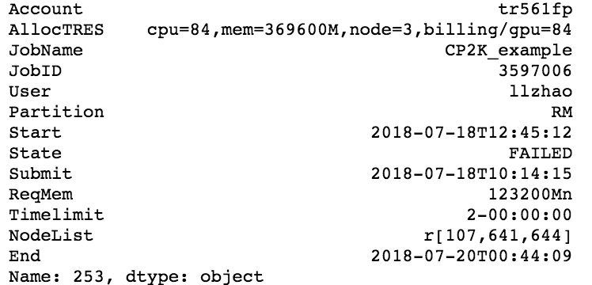
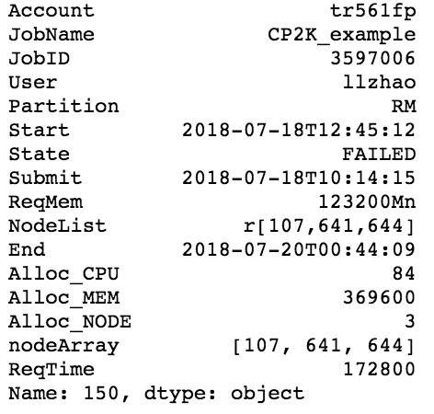
Data Preprocessing (1) – Job Transform
Take RM Node as an example
AllocTRES cpu=32,mem=123200M,node=1,billing/gpu=32,gres/gpu=2,gres/gpu:p100=2
NodeList r[ 107, 108-110, 131, 565]
NodeList l[ 003, 004-005, 009],xl[ 001, 002]

Slide 18
Data Preprocessing (2) - Time
(submit) (start)
Transform start and end time to minute per row (like taking snapshot)
If a job has a start time of 2018-07-19T13:28:35 and end time of 2018-07-19T13:32:21 in sacct, this single job will be converted to four rows with timestamp like the following:
2018-07-19T13:28:35
2018-07-19T13:32:21
2018-07-19
13:28:00
2018-07-19
13:29:00
2018-07-19
13:30:00
2018-07-19
13:31:00
2018-07-19
13:32:00
2018-07-19
13:33:00
***A job that run/waits for 10 days to be executed would have 60*24*10= 14400 rows

Slide 19
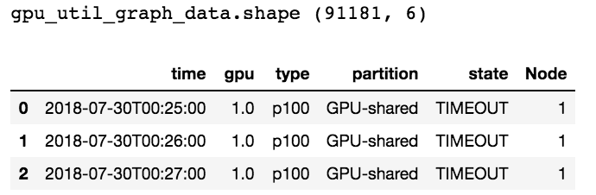
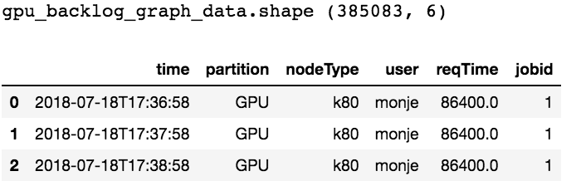
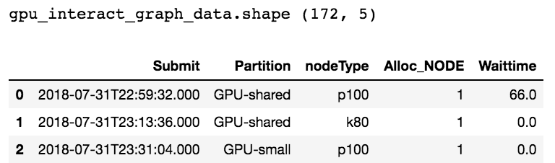
Preprocessed Data (August 1st –August 3rd )
GPU
Utilization
Backlog
Original
(2374, 18)
Interactive

Slide 20
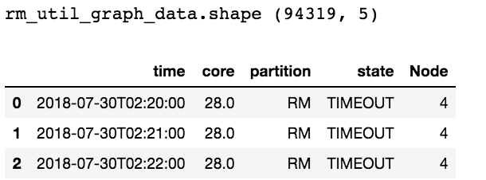
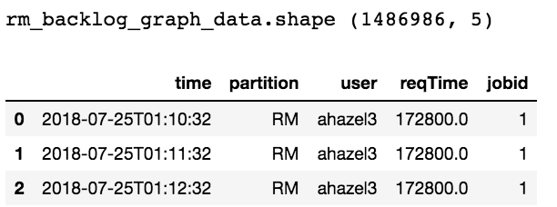
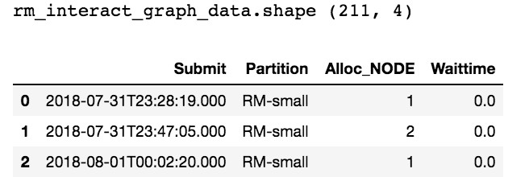
Preprocessed Data (August 1st –August 3rd )
RM
Utilization
Backlog
Original
(8306, 18)
Interactive

Slide 21
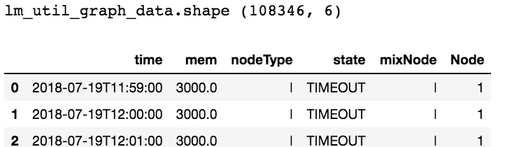
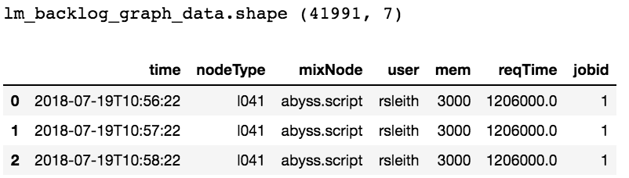
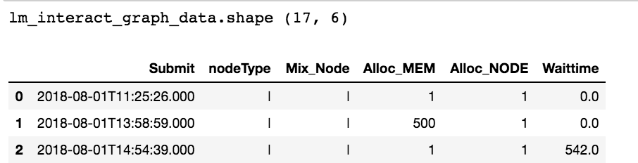
Preprocessed Data (August 1st –August 3rd )
LM
Utilization
Backlog
Original
(4170, 18)
Interactive

Slide 22
5. Dashboard Demo

Slide 23

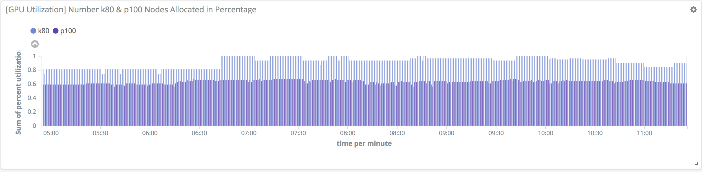
GPU Utilization
Time Spam: 2018-07-19 04:29:00 – 2018-07-20 11:30
Graph1: Percentage of GPUs Assigned by Node Type
K80 & P100 both have 64 GPUs

Slide 24
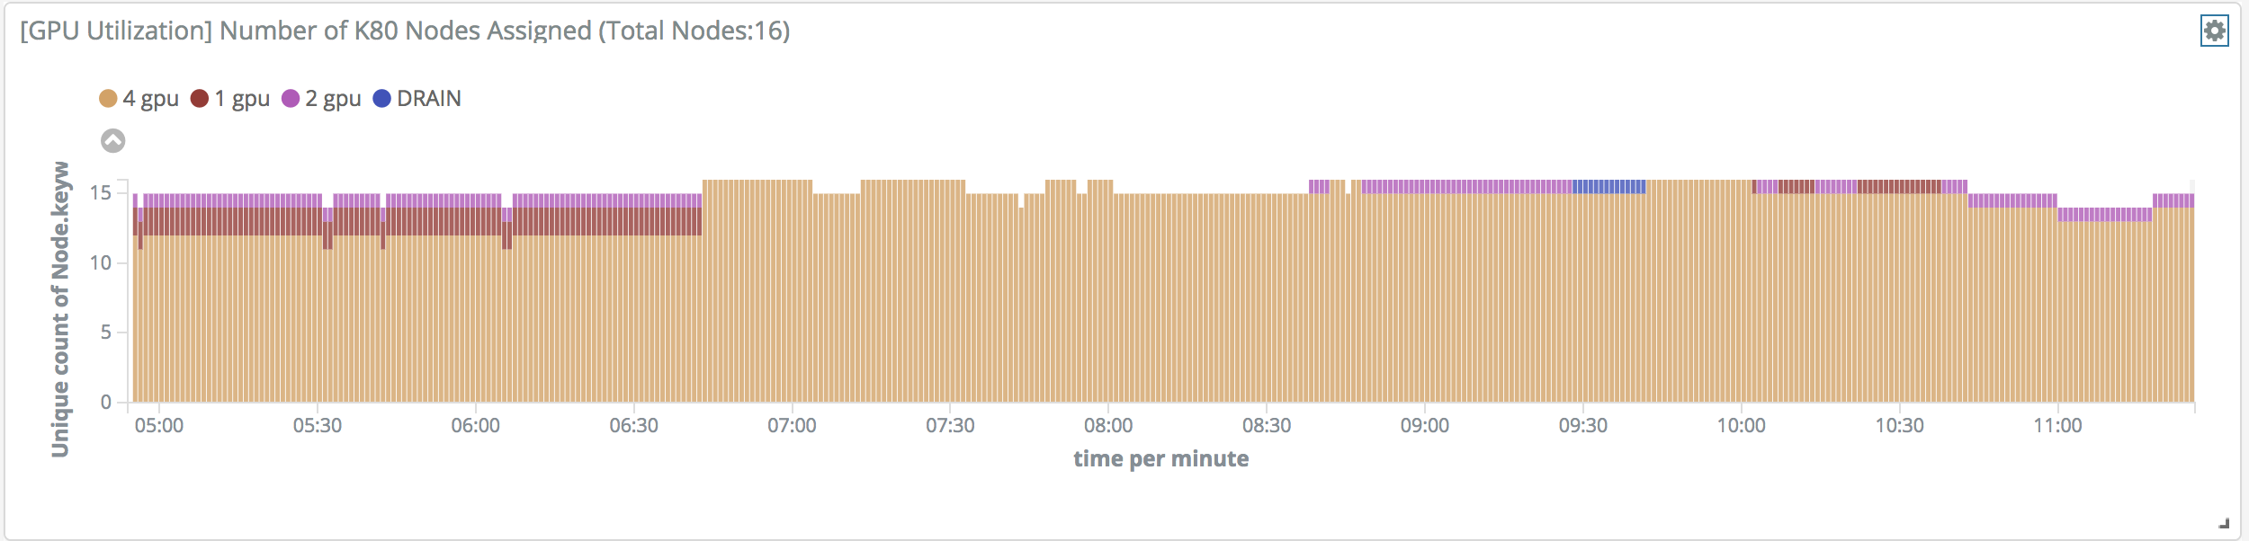
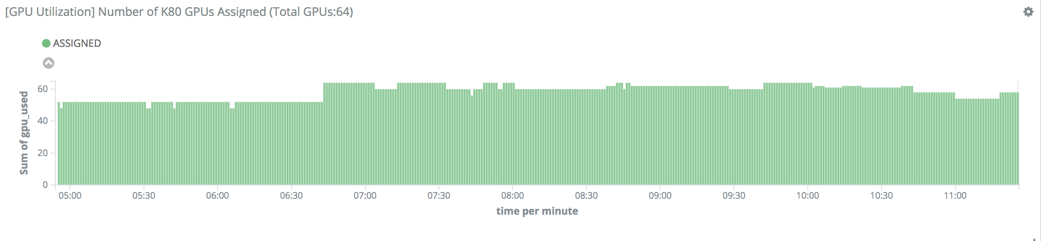
GPU Utilization
Graph2: Number of K80 Nodes Assigned (Total Nodes: 16)
Graph3: Number of K80 GPUs Assigned (Total GPUs: 64)
*** Drain Nodes: no further job will be scheduled on that node, but the currently running jobs will keep running

Slide 25
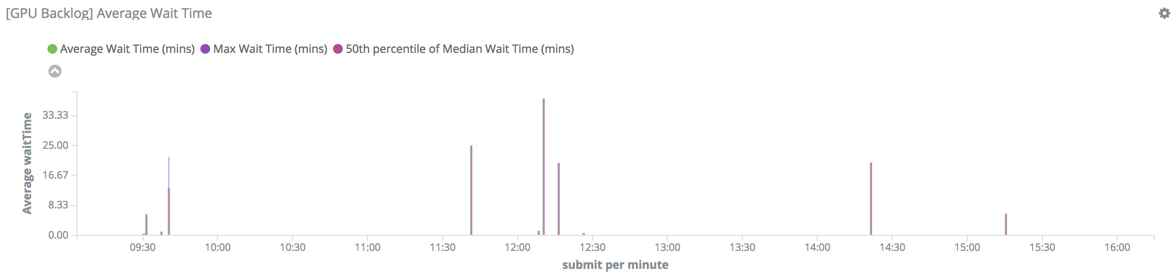
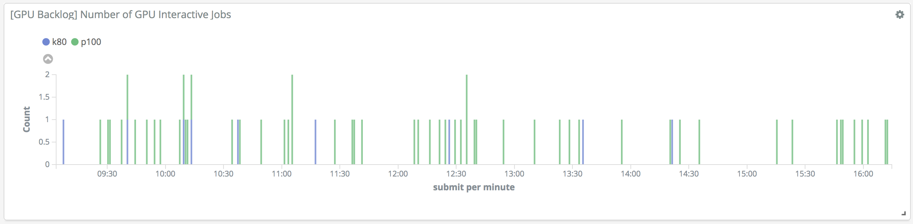
GPU Backlog
Graph 4: Average/Median/Max Wait Time for Interactive Jobs
Graph 5: Number of GPU Interactive Jobs by Node Type

Slide 26
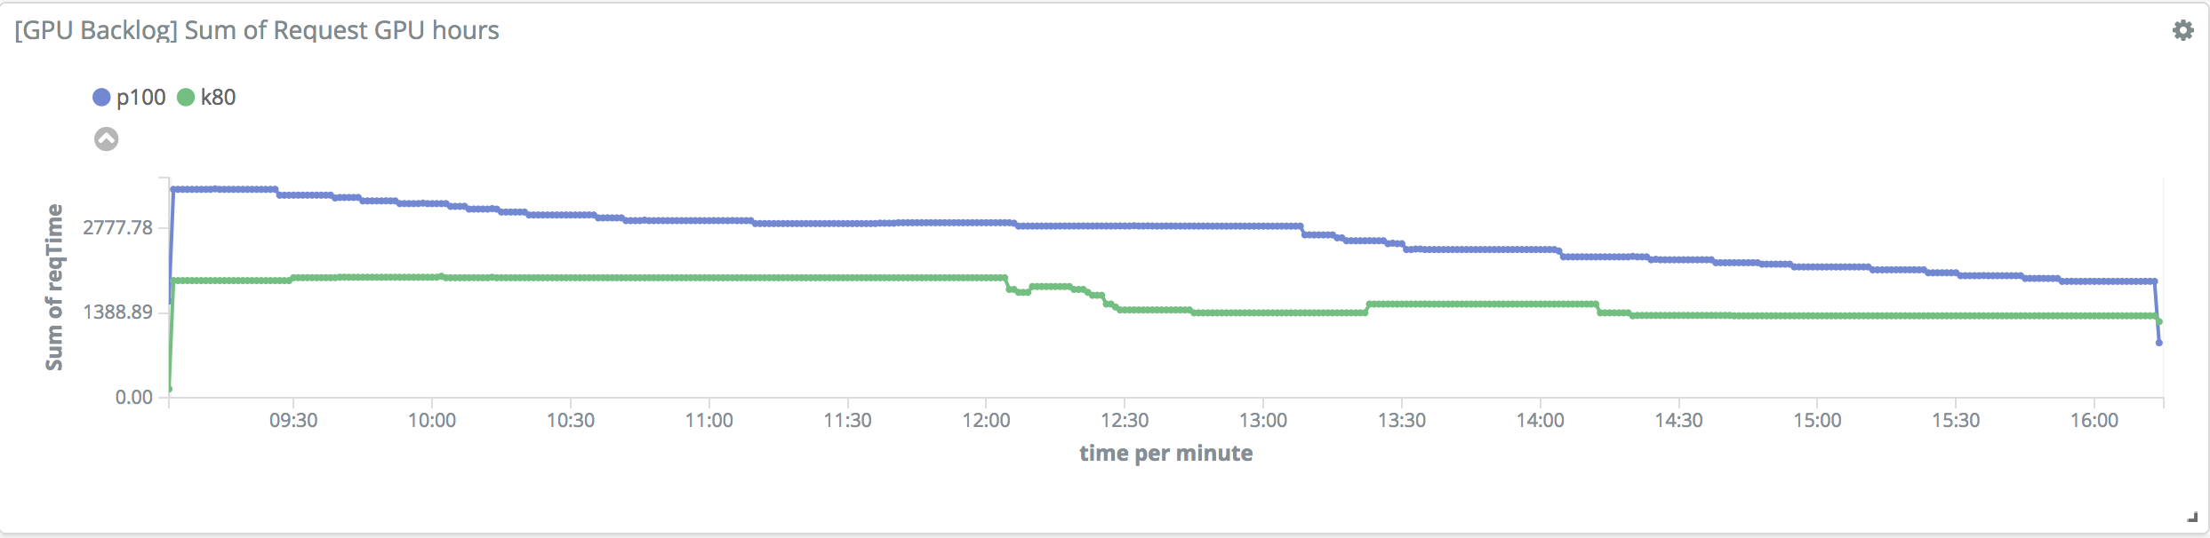
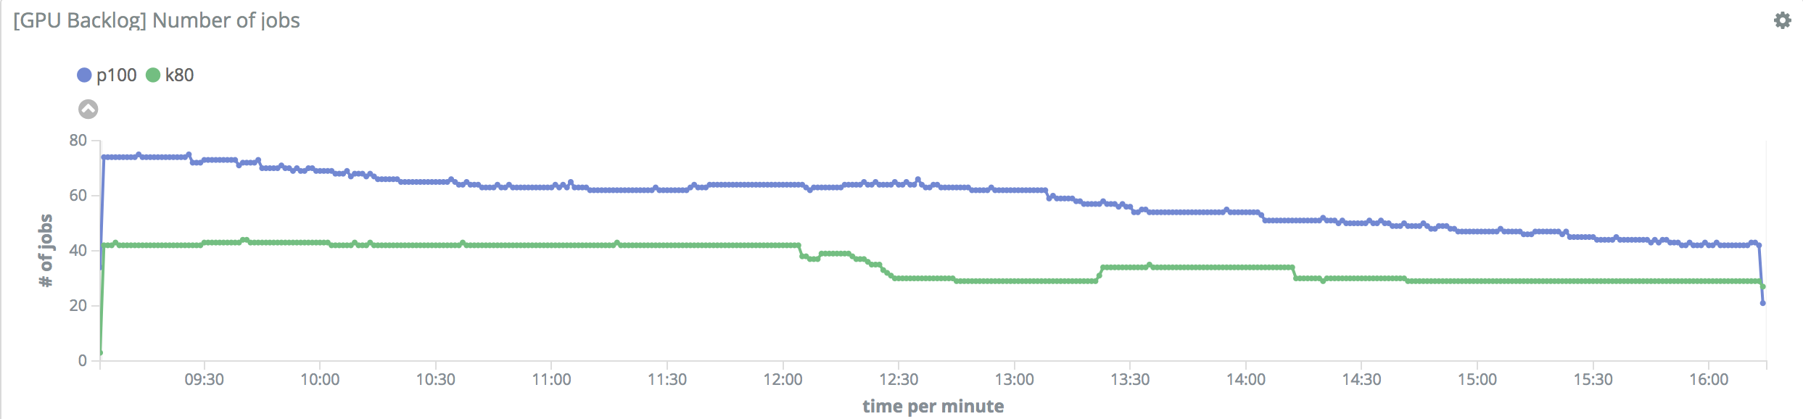
GPU Backlog
Graph 6: Sum of Request GPU Hours by Node Type
Graph 7: Total Number of Jobs by Node Type

Slide 27
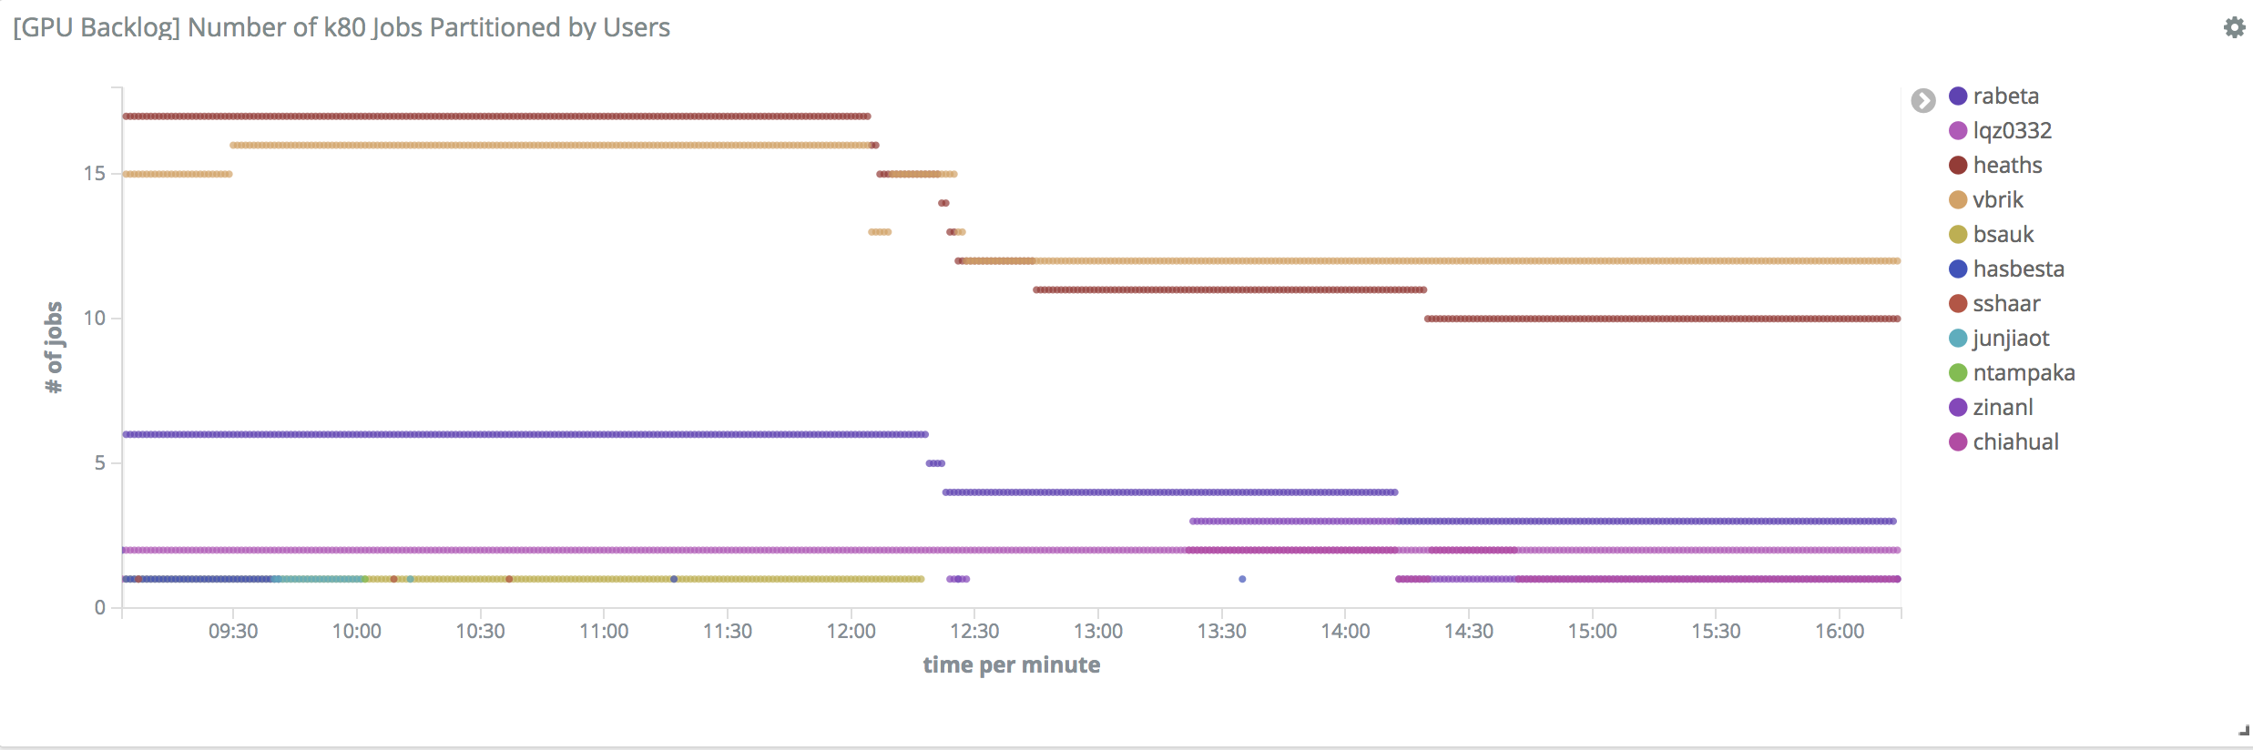
GPU Backlog
Graph 8: Total Number of Jobs by user

Slide 28

6. Project Benefits for PSC

Slide 29

Monitor the Utilization & Backlog of different resources on Bridges in longer time span, not just snapshot
Manage Allocations more efficiently

Slide 30
Thanks!
Any
questions
?
You can find me at
chiahual@andrew.cmu.edu

